Slide 1
AUTOMATION SOLUTION
Automated
Architecture Diagram
Generation from BOMs
Transforming BOM Data into DeltaV Architecture Visualizations
An intelligent automation pipeline that ingests BOM spreadsheets, classifies DeltaV components, and generates professional architecture diagrams — eliminating hours of manual engineering work.
PROJECT TEAM
Harsh Konde
Rishi Motwani
Devansh Kale
Mohammedmunsif Surve

Slide 2
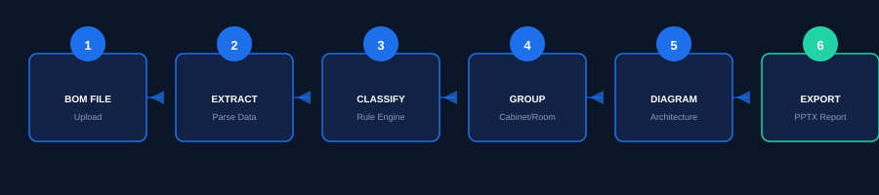
WORKFLOW OVERVIEW
Problem → Solution → Workflow
PROBLEM
SOLUTION
Manual architecture creation from BOMs is slow, repetitive, and error-prone. Engineers spend days analyzing spreadsheets to produce diagrams that could be automated.
Automated processing pipeline that ingests BOM files, classifies DeltaV components, groups them by cabinet and room, and generates accurate architecture diagrams and reports.
→
AUTOMATED PROCESSING PIPELINE
Python
Streamlit
FastAPI
Pandas
python-pptx

Slide 3
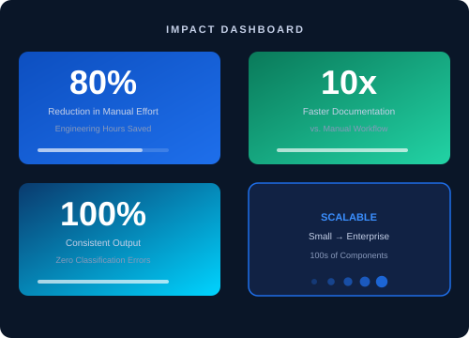




IMPACT & VALUE
Impact & Value Delivered
KEY BENEFITS
Reduced Engineering Effort
Faster Documentation Cycle
Improved Accuracy & Consistency
Standardized Professional Outputs
Scalable for Large Industrial Projects
FUTURE SCOPE
AI-Assisted Component Classification
Support for Additional Control Systems
Cloud Deployment & Advanced Analytics
From BOM Data to Architecture Insights — Automated, Accurate, Scalable.

